Slide 1

An Automated COVID-19 SOPs Monitoring And Management System
GSN: FALL 21-18
Presented by:
Maaheen Yasin (L18-1267)
Inbisat Mudassar Dar (L18-1283)
Ahmad Tameem Kamal (L18-1358)
Advisor: Mr. Hamza Yousuf
Client: Saleem Steel Industries
Evaluation Committee:
Ms. Shazia Haque
Mr. Zeeshan Asif

Slide 2

Completed Tasks
Prototype Design: Exterior
Prototype Design: Interior
Door Lock
Demonstration
Remaining Tasks
CONTENTS

Slide 3


Tasks Completed
Seven Main Deliverables:
Face Mask Detection
Social Distancing Detection
Temperature Sensing
SpO2 Sensing
Warning Generation using Audio
Audio Assistance
Automated Door Lock Mechanism
Partially Done

Slide 4
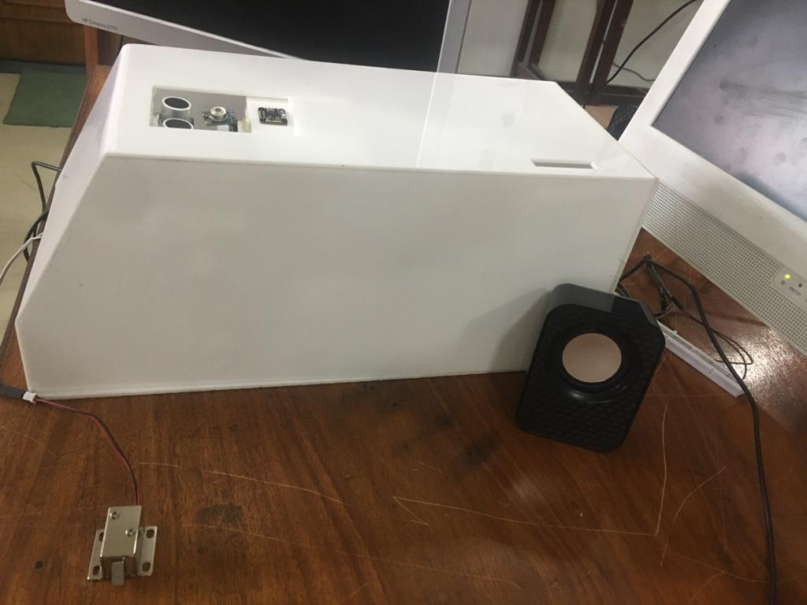
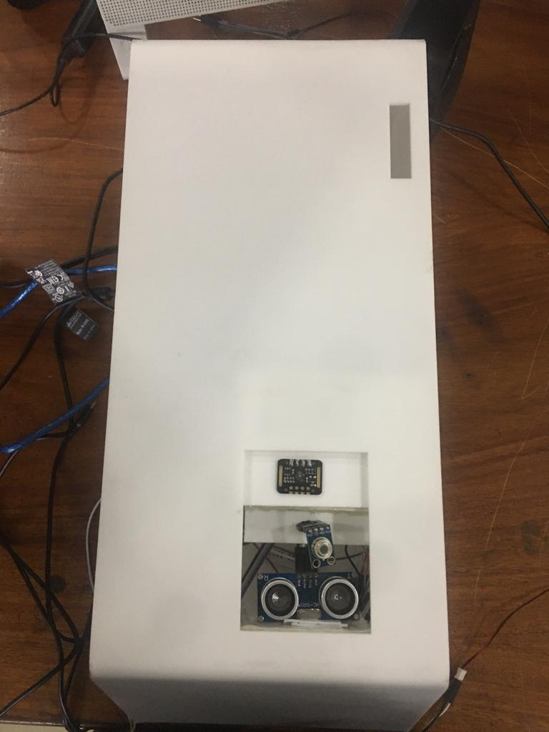
Prototype Design: Exterior
Side View of Prototype
Top View of Prototype

Slide 5
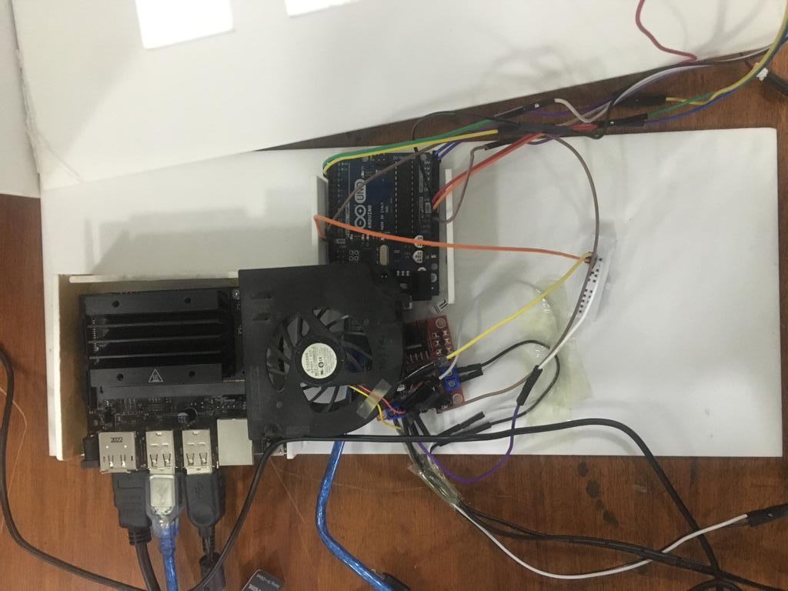
Prototype Design: Interior

Slide 6
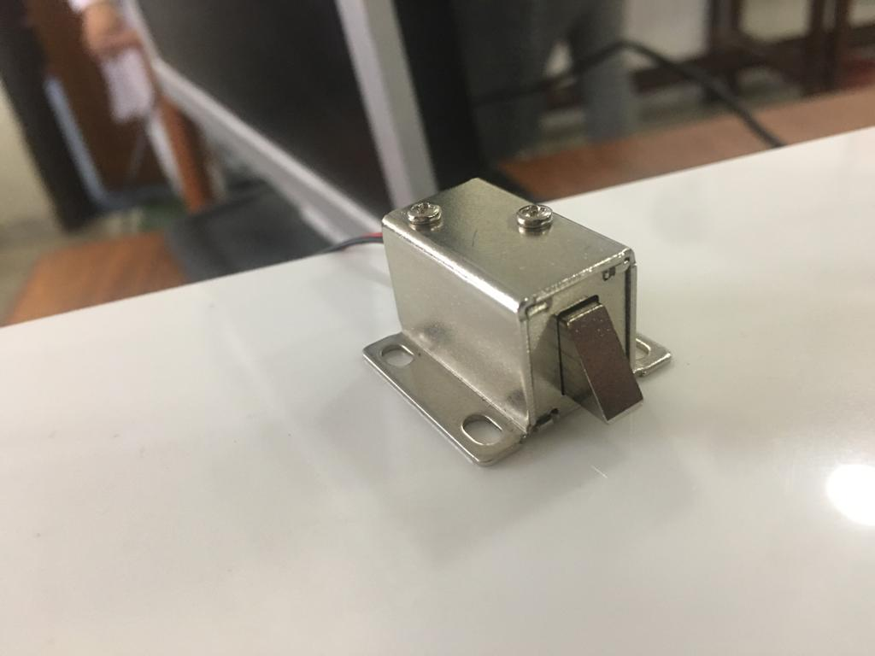
Door Lock
5V Rating, Compatible with Arduino Uno
Connected with Driver Module

Slide 7
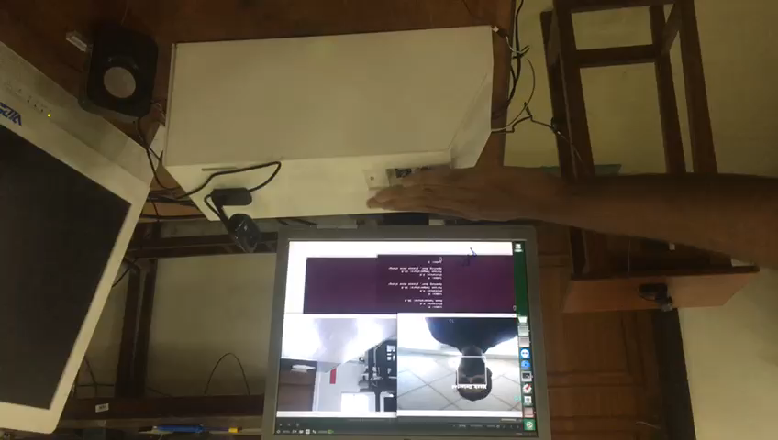
Demonstration

Slide 8
Remaining Tasks
Integrate Door Lock and Warning Generation using Audio with Social Distancing and SpO2 sensing

Slide 9


